Slide 1


TechDocs – Backend services
Backend services
Application backend for a smooth process flow
Great Learning

Slide 2
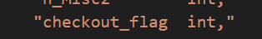
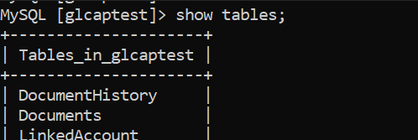
Server connectivity and configuration
About the services
Connect to server
These services handle code functions, server configurations, and customer data
Developers outsource all the behind-the-scenes aspects of a web application so that they only have to write and maintain the frontend.
Application demand these must be up and running at virtually all times ensuring a smooth process flow
*Some scenarios, have been simplified here for brevity
Backend configuration steps are mentioned in README.md file under GL-IIIT-TechDocs/backend directory.
Connection to MySQL RDS instance
Update the schema definition and object-relational mapping for changes (def_tables.py, orm_Common.py, orm_Tables.py)
Create the schema by running def_tables.py
Configure the template folder for the backend flask app (app.py). Static folder for images, if necessary

Slide 3

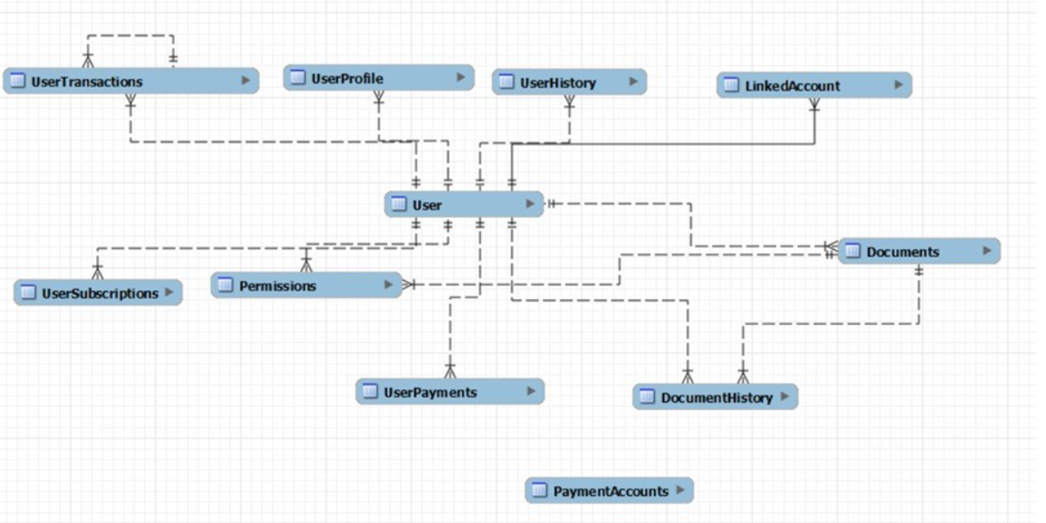
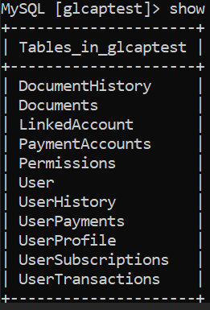
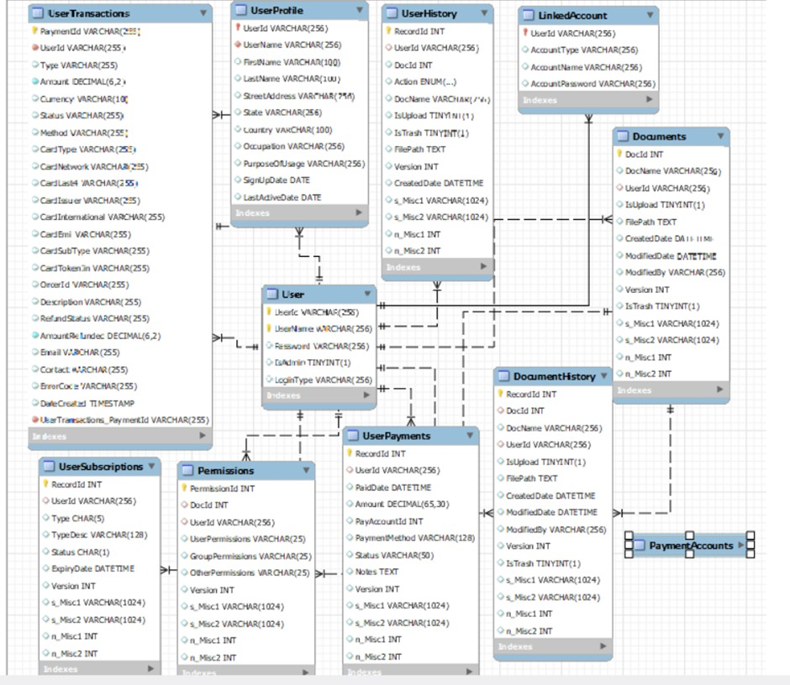
Logical Data Model
Database -

Slide 4
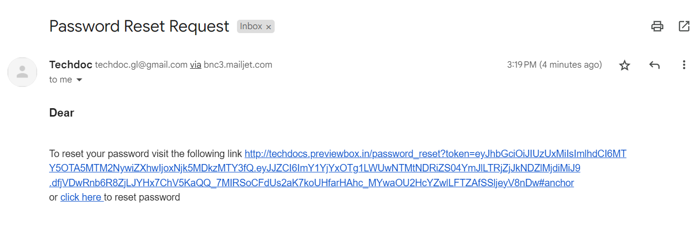
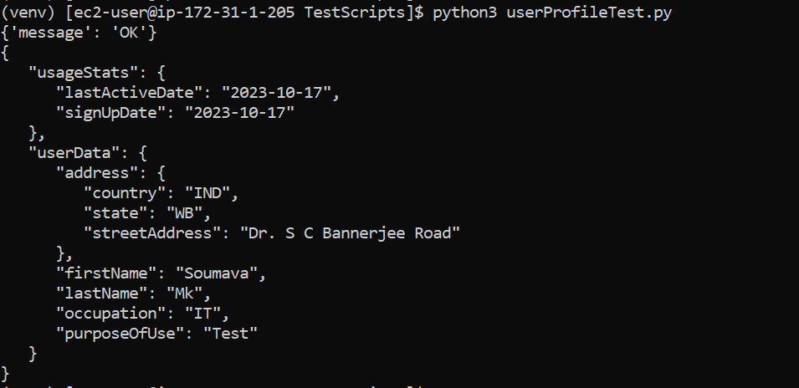
User registration
User login
Password reset when forgotten (forgotpwdTest.py)
User Access management
Profile update and review

Slide 5
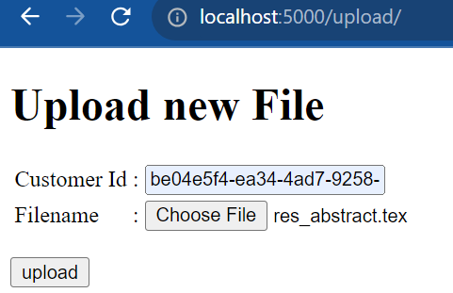
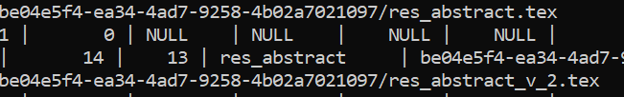
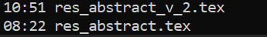
File Management
File Upload
Version control
1
2
3
File permission function

Slide 6
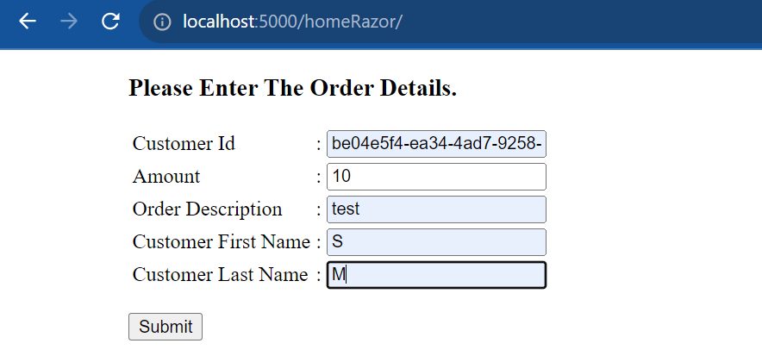
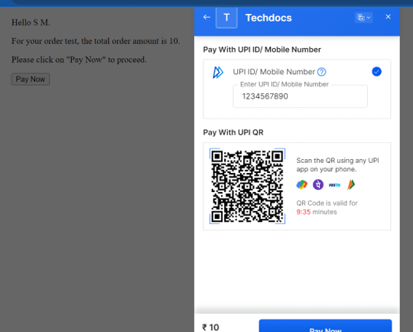
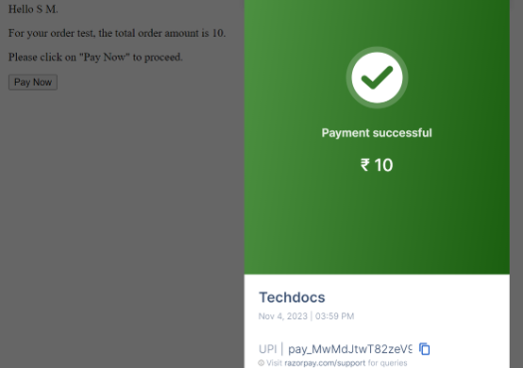

Payment API
TechDocs – Backend services
Enter detail
Select option and make payment. Order generated.
On checking out payment is made.
1
2
3

Slide 7
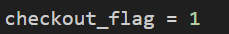
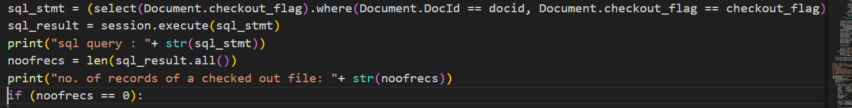
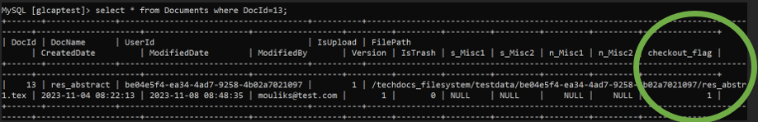
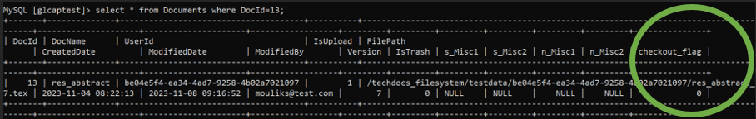
Check if the file is already checked out by others
Multi-user editing
While one is updating a document the checkout flag is set (Document.checkout_flag=1) restricting others to modify the same document
Once the update is done the checkout flag is reset (Document.checkout_flag=0) making the document editable by others.

Slide 8
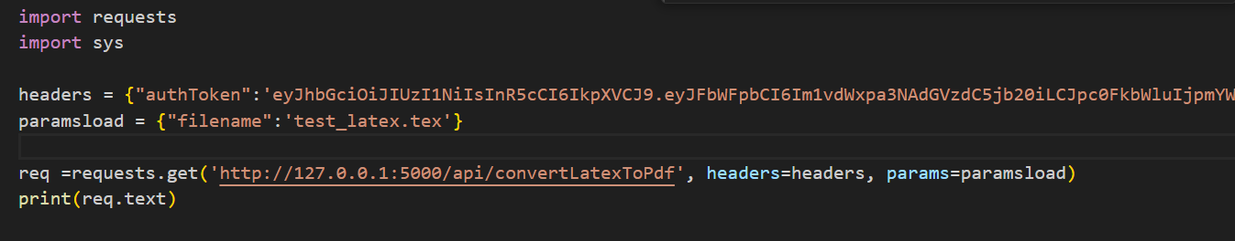
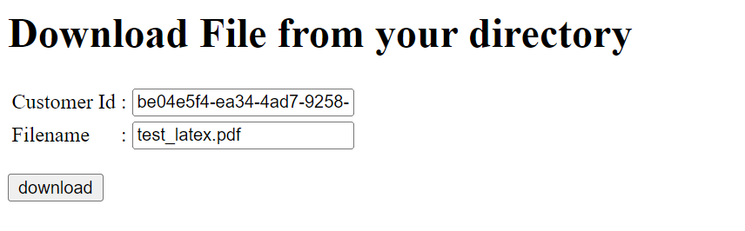
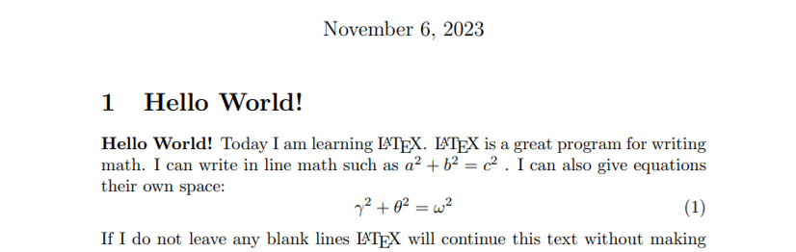
Latex to PDF conversion and download
1
User can convert latex files only from his/her repository
2
Selected latex file is converted to PDF in user specific repository
3
Converted file may be downloaded from the user repository into the client computer
4
PDF file viewed from client computer

Slide 9
Thank you
Backend team, Great Learning

